Slide 1

Lists and Tuples in Python
Dr. Rakhee Chhibber

Slide 2
Lists - Introduction
a list is a built-in dynamic sized array (automatically grows and shrinks). We can store all types of items (including another list) in a list.
  Can contain duplicate items.
  Mutable : We can modify, replace or delete the items.
  Ordered : Maintains the order of elements based on how they are added.
  Items can be accessed directly using their position (index), starting from 0.
  May contain mixed type of items, this is possible because a list mainly stores references at contiguous locations and actual items maybe stored at different locations.

Slide 3
Creating a list
Using [] bracket
  countries = ["United States", "Canada", "Poland", "Germany", "Austria"]
Using constructor – list()
  Digits=list(range(10))
Converting tuple in list
  L=list((1,2,3,4))

Slide 4
Creating a list from existing sequence
L1=list(“hello”
T=(‘w’,’e’,’t’,’h’)
L2=list(t)
L3=list(input(“enter list elements”)
For example enter = 123456

Slide 5
Creating List with Repeated Elements
a = [2] * 5

Slide 6
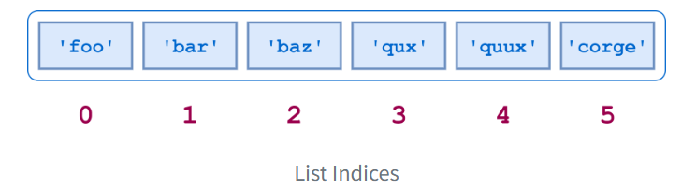
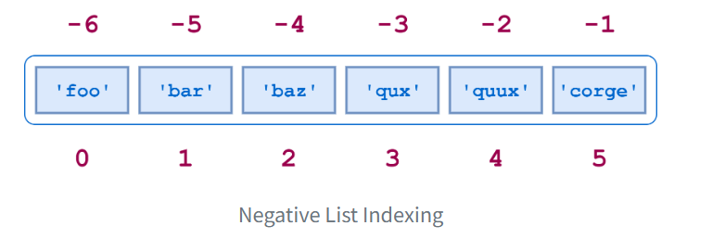
Accessing list elements
words = ["foo", "bar", "baz", "qux", "quux", "corge"]

Slide 7
Tell the output
words[-1]
words[-2]
words[-len(words)]
words[2:5]
words[-5:-2]
words[1:4]
words[-5:-2] == words[1:4]
words[:4]
words[0:4]
words[2:]
words[2:len(words)]
words[:4] + words[4:]
words[:4] + words[4:] == words
"qux" in words

Slide 8
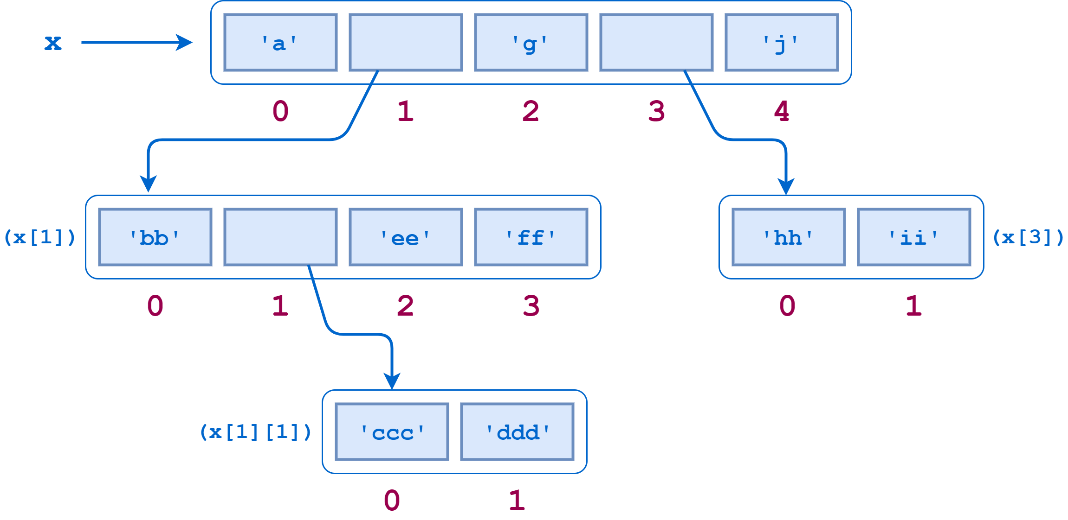
Nested List
x = ["a", ["bb", ["ccc", "ddd"], "ee", "ff"], "g", ["hh", "ii"], "j"]

Slide 9
State the output
x[0], x[2], x[4]
x[1]
x[3]
x[1][0]
x[1][1]
x[1][2]
x[1][3]
x[1][1][0]
x[1][1][1]

Slide 10
Comparing the list
L1=[1,2,3,4]
L2=[5,6,7,8]
L3=[1,2,3,4]
L1==l2
L1==l3
L1>l2
L1<l3

Slide 11
Making true copy of list
A=[1,2,3,4]
B=A
A[1]=5
Print(b)
Separate copy
B=list(a)

Slide 12
List operations and functions
Append()
Extend()
Insert()
Pop()
Remove()
Clear()
Count()
Reverse()
Sort()
Joining the lists - +
Repeating or replicating list - *
Slicing the list
Len(list)
Max(list)
Min(list)
Sum(list)

Slide 13
Iterating Over Lists
a = ['apple', 'banana', 'cherry']
# Iterating over the list
for item in a:
print(item)

Slide 14
List Comprehension in Python
List comprehension is a concise way to create lists using a single line of code. It is useful for applying an operation or filter to items in an iterable, such as a list or range.
# Create a list of squares from 1 to 5
squares = [x**2 for x in range(1, 6)]
print(squares)

Slide 15
Tuples

Slide 16
Tuple
A tuple in Python is an immutable ordered collection of elements.
Tuples are similar to lists, but unlike lists, they cannot be changed after their creation (i.e., they are immutable).
Tuples can hold elements of different data types.
The main characteristics of tuples are being ordered , heterogeneous and immutable.

Slide 17
Creating a Tuple
tup = ()
print(tup)
# Using String
tup = ('Geeks', 'For')
print(tup)
# Using List
li = [1, 2, 4, 5, 6]
print(tuple(li))
# Using Built-in Function
tup = tuple('Geeks')
print(tup)

Slide 18
Creating a Tuple with Mixed Datatypes.
tup = (5, 'Welcome', 7, 'Geeks')
print(tup)

Slide 19
Creating a Tuple with nested tuples
tup1 = (0, 1, 2, 3)
tup2 = ('python', 'geek')
tup3 = (tup1, tup2)
print(tup3)

Slide 20
Creating a Tuple with repetition
tup1 = ('Geeks',) * 3
print(tup1)

Slide 21
Creating a Tuple with the use of loop
up = ('Geeks')
n = 5
for i in range(int(n)):
tup = (tup,)
print(tup)

Slide 22
Accessing of Tuples
# Accessing Tuple with Indexing
tup = tuple("Geeks")
print(tup[0])
# Accessing a range of elements using slicing
print(tup[1:4])
print(tup[:3])
# Tuple unpacking
tup = ("Geeks", "For", "Geeks")
# This line unpack values of Tuple1
a, b, c = tup
print(a)
print(b)
print(c)

Slide 23
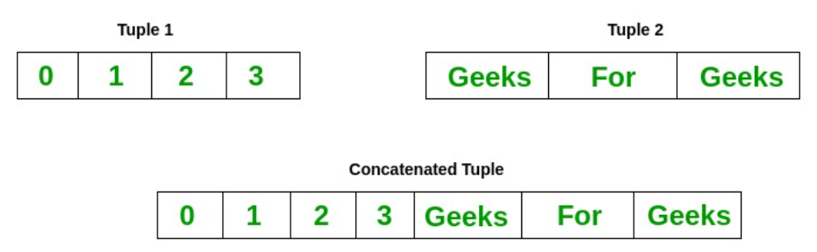
Concatenation of Tuples

Slide 24
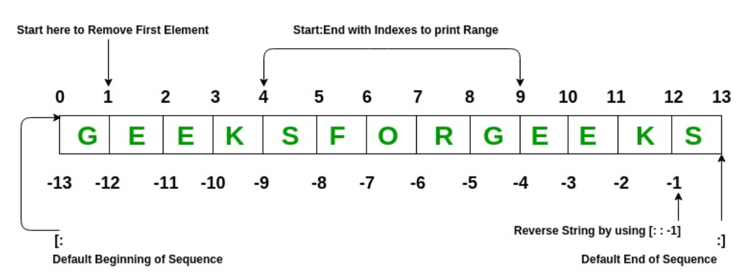
Slicing of Tuple

Slide 25
tup = tuple('GEEKSFORGEEKS')
# Removing First element
print(tup[1:])
# Reversing the Tuple
print(tup[::-1])
# Printing elements of a Range
print(tup[4:9])

Slide 26
Deleting a Tuple
tup = (0, 1, 2, 3, 4)
del tup
print(tup)

Slide 27
Tuple Unpacking with Asterisk (*)
tup = (1, 2, 3, 4, 5)
a, *b, c = tup
print(a)
print(b)
print(c)

Slide 28
Thank You

